Slide 1


Slide 2
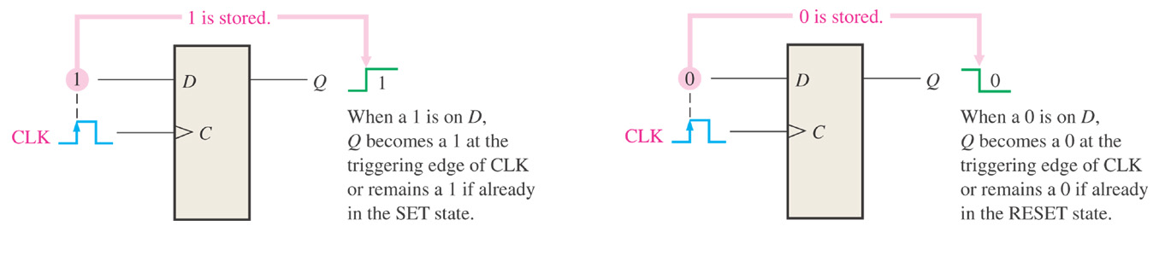
9.0 Registers
One or more flip-flops used to store and shift data

Slide 3
D3
D Q
Q3
A 4-Bit Register
CLK
D2
D Q
Q2
D Q
D
Q
4
4
CLK
D1
D Q
Q1
CLK
CLK
D0
D Q
Q0
CLK
Could be called a parallel-in/parallel-out register.

Slide 4
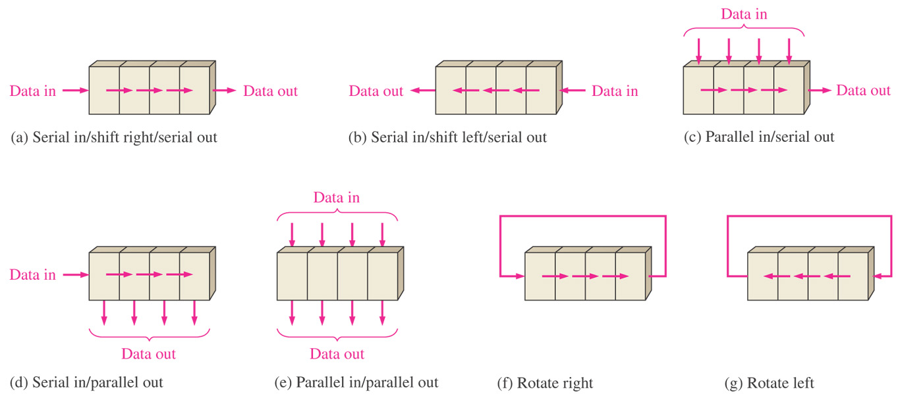
9.1 Basic Shift Register Functions
Figure 9–2 Basic data movement in shift registers. (Four bits are used for illustration. The bits move in the direction of the arrows.)

Slide 5
9.2 Serial IN/Serial OUT Shift Registers
Accepts data serially
  One bit at a time on a single line
  Produces the stored information on its output also in serial form

Slide 6
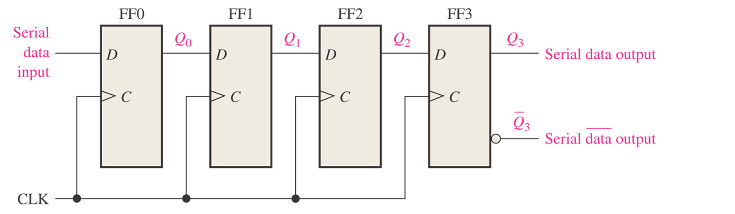
Figure 9–3 Serial in/serial out shift register.

Slide 7
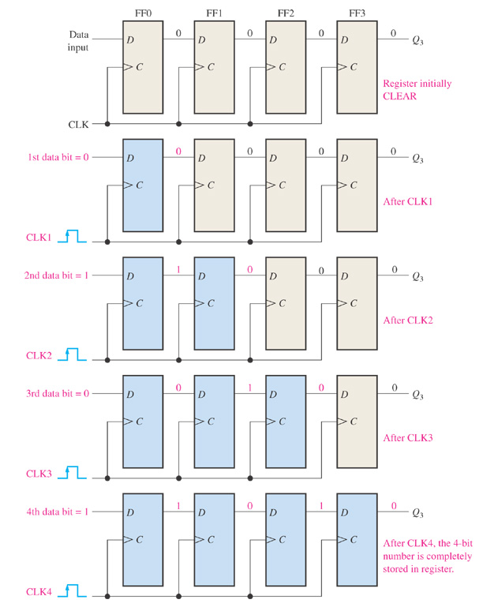
Four bits (1010) being entered serially into the register

Slide 8
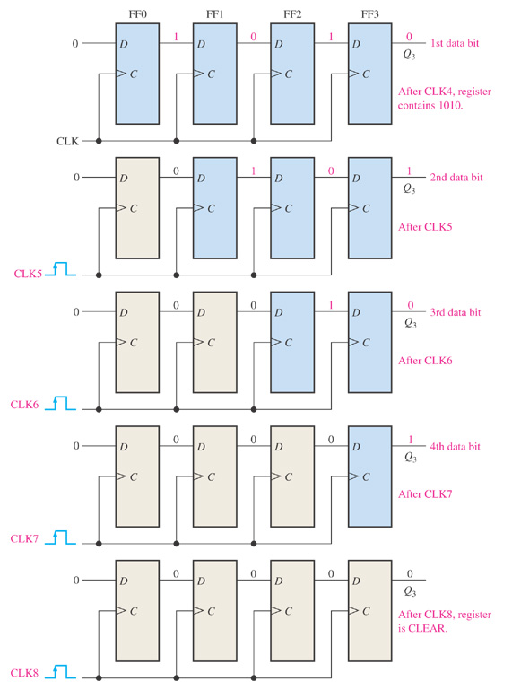
Four bits (1010) being serially shifted out of the register and replaced by all zeros

Slide 9
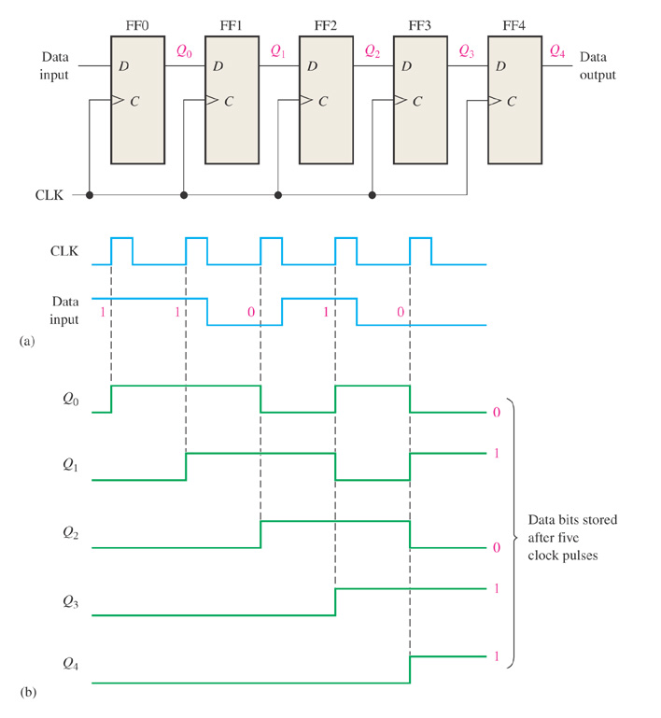
Example: Show the states of the 5-bit register in Fig. 9-6(a) for the specified data input and clock waveform. Assume that the register is initially cleared.
Fig. 9-6(a)

Slide 10
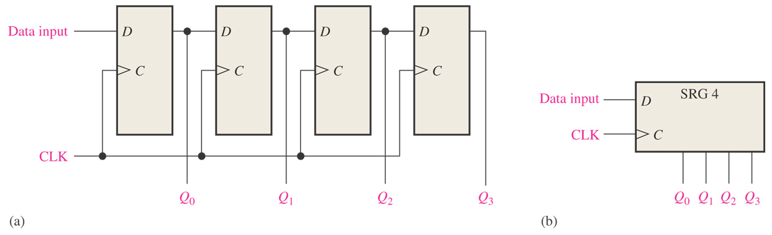
9.3 Serial IN/Parallel OUT Registers
Data bits enter into registers serially
Data bits are taken out of the registers in the parallel way

Slide 11
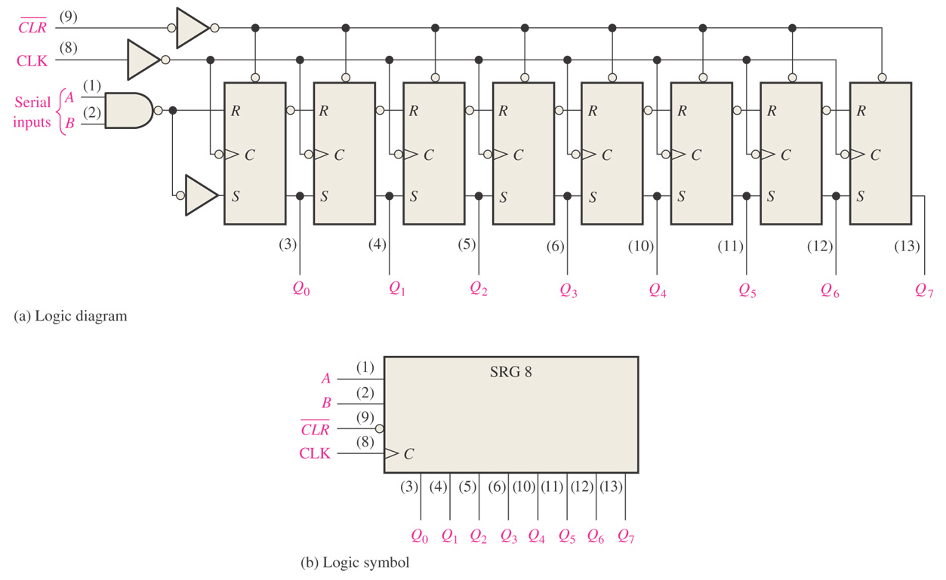
Figure 9–10 The 74HC164 8-bit serial in/parallel out shift register.

Slide 12
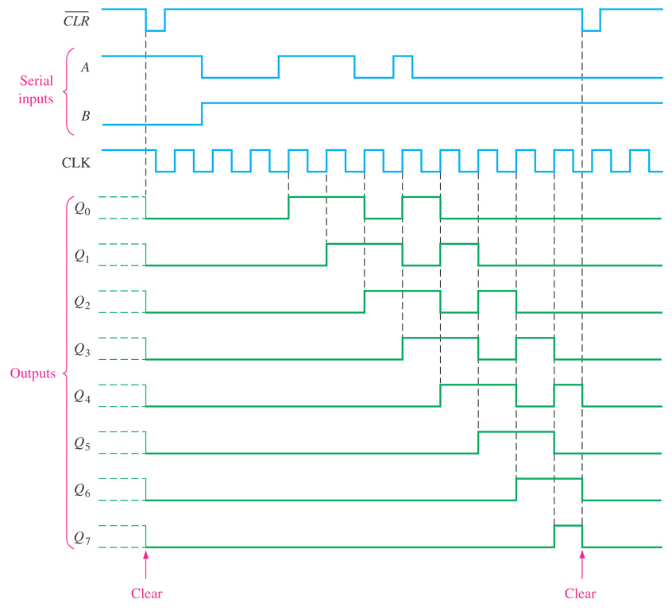
Figure 9–11 Sample timing diagram for a 74HC164 shift register.

Slide 13
9.4 Parallel IN/Serial OUT Shift Registers
Parallel inputs
Serial outputs

Slide 14
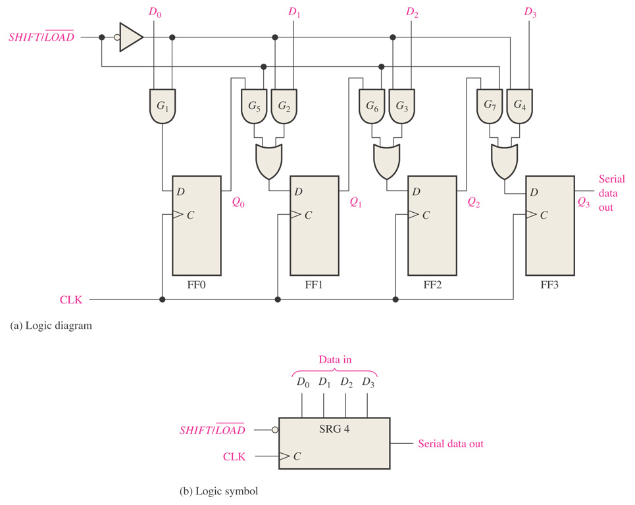
Figure 9–12 A 4-bit parallel in/serial out shift register.

Slide 15
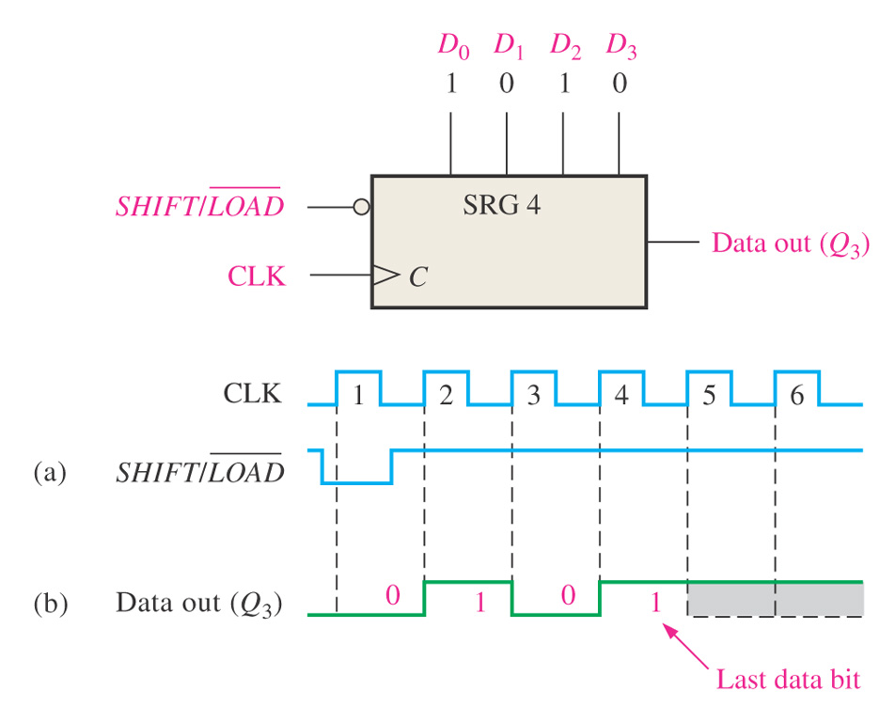
Example: Show the data-output waveform for a 4-bit register with the parallel input data and the clock and other control signal.

Slide 16
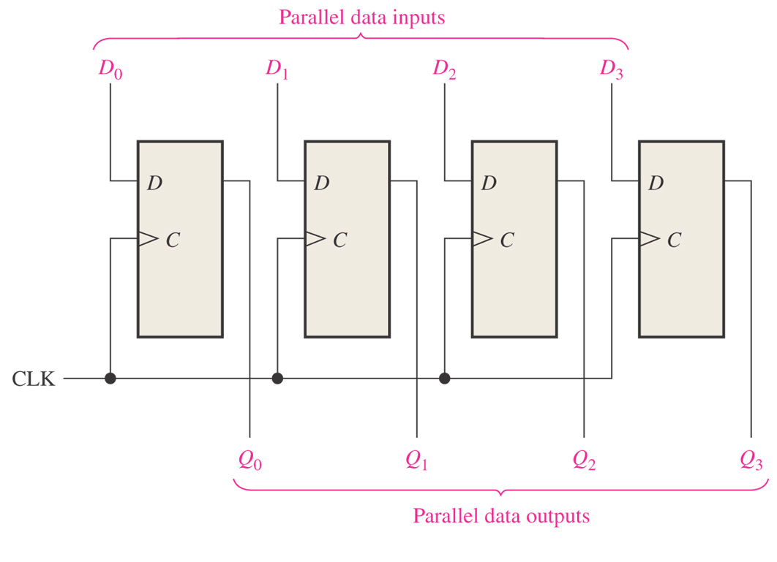
9.5 Parallel IN/Parallel OUT Registers

Slide 17
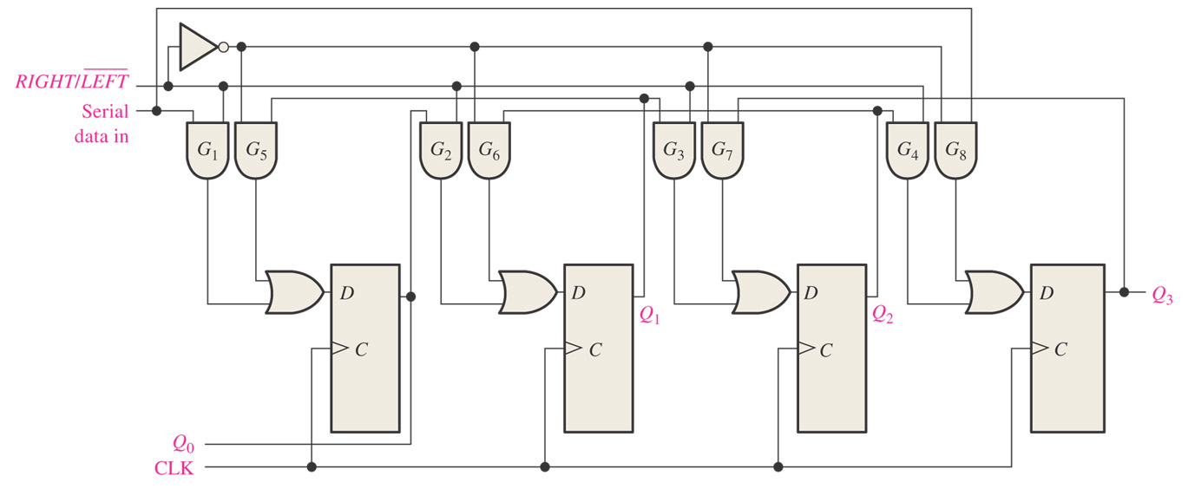
9.6 Bidirectional Shift Registers
Fig. 9-19 Four-bit bidirectional shift register

Slide 18
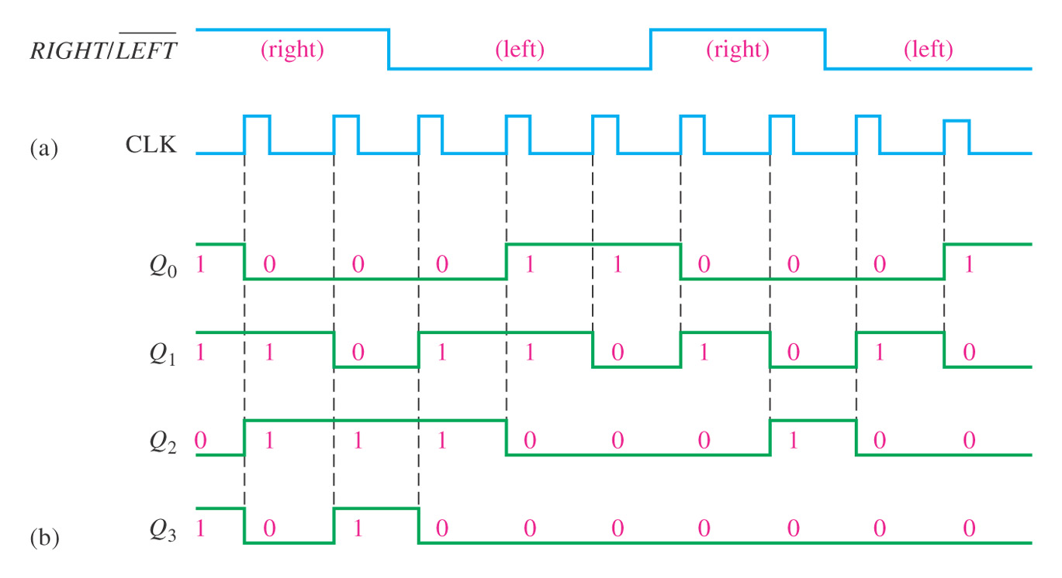
Example: Determine the state of the shift register of Fig. 9-19 after each clock pulse for the given control signals. Assume that the serial data-input line is LOW.

Slide 19
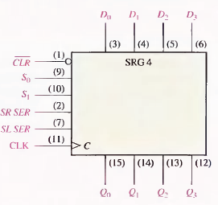
The 74HC194 4-bit bidirectional universal shift register

Slide 20
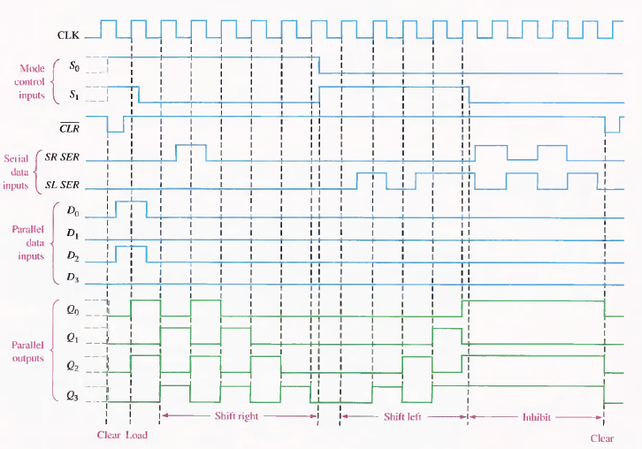
Sample timing diagram for a 74HC194 shift register

Slide 21
9.7 Shift Register Counters
The Johnson Counter
The Ring Counter

Slide 22
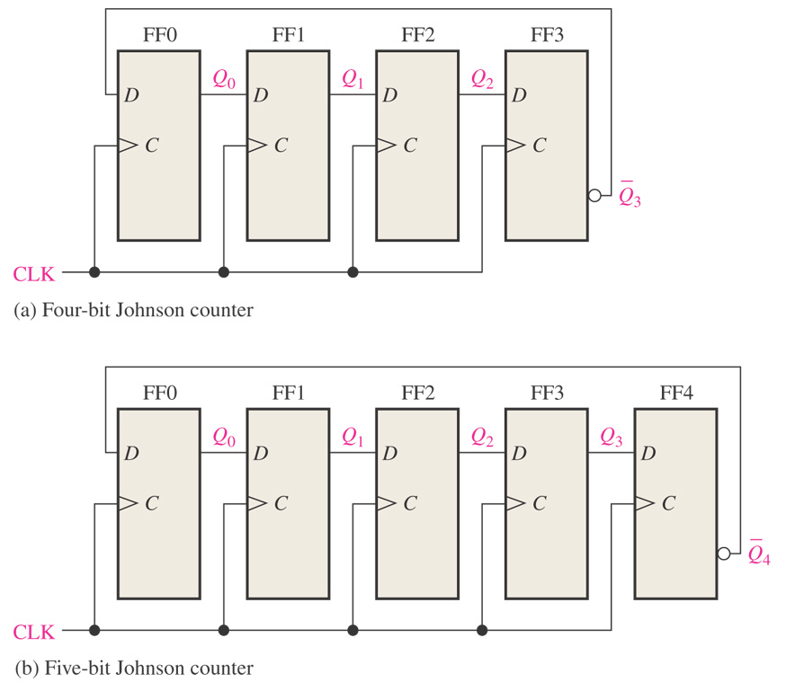
Figure 9–23 Four-bit and 5-bit Johnson counters.

Slide 23
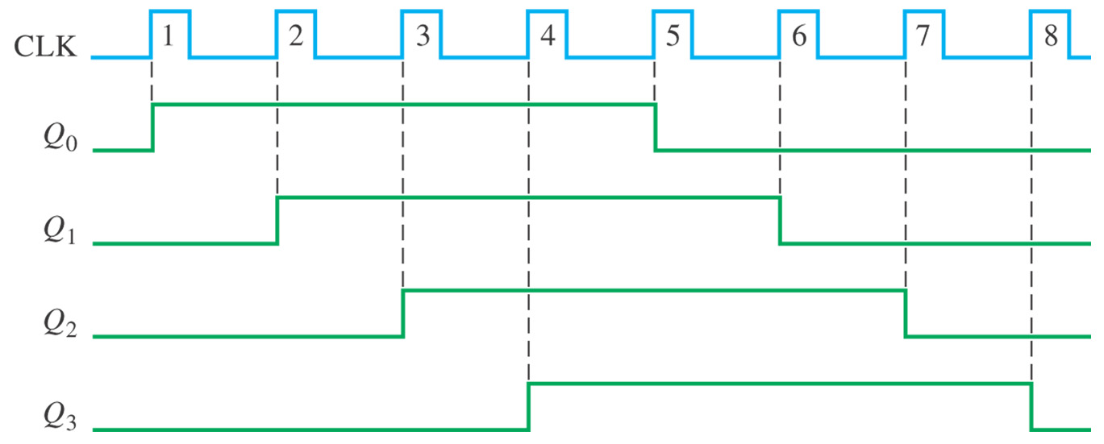
Figure 9–24 Timing sequence for a 4-bit Johnson counter.

Slide 24
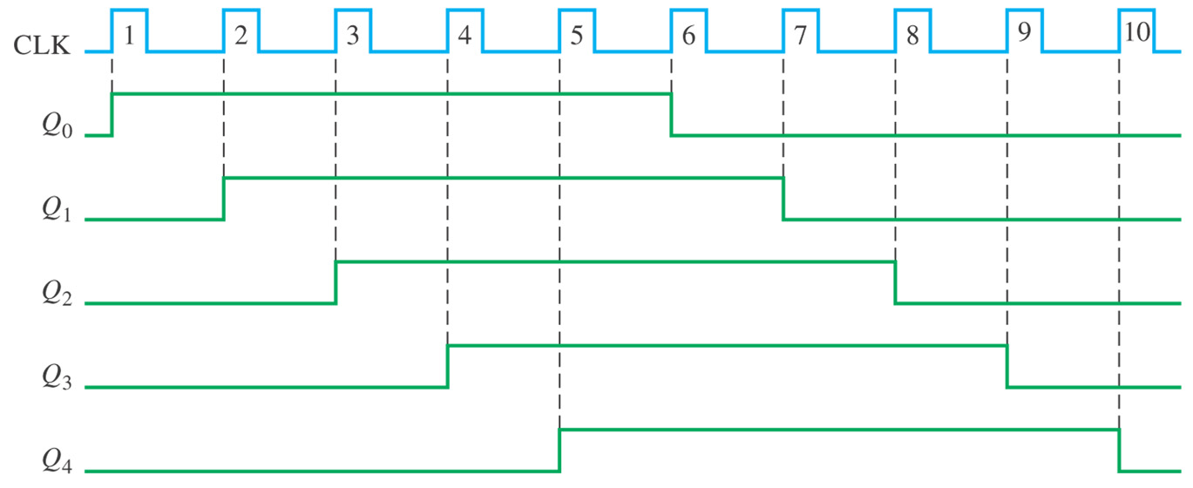
Figure 9–25 Timing sequence for a 5-bit Johnson counter.

Slide 25
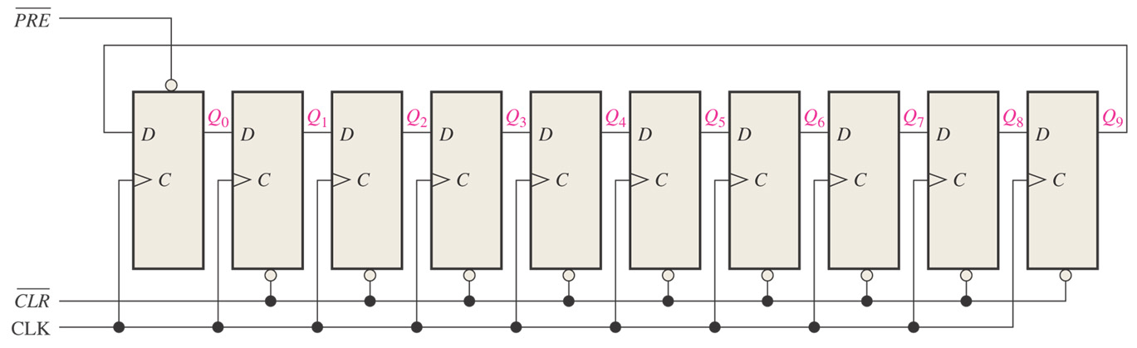
Figure 9–26 A 10-bit ring counter.

Slide 26
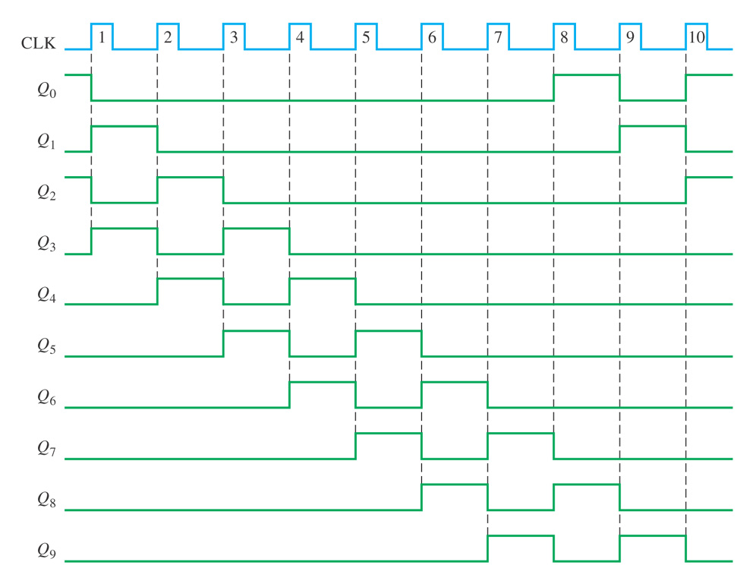

Slide 27
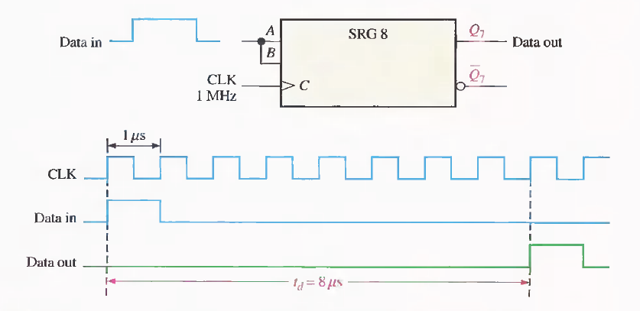
9.8 Shift Register Applications
Time delay

Slide 28
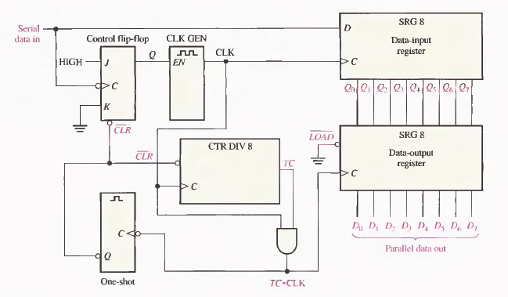

Serial to parallel data converter

Slide 29
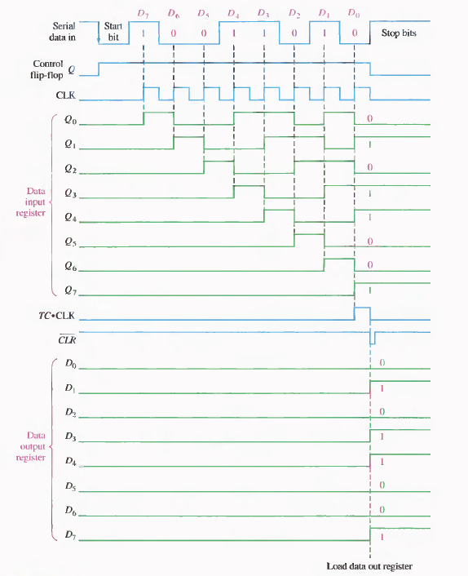

Slide 30
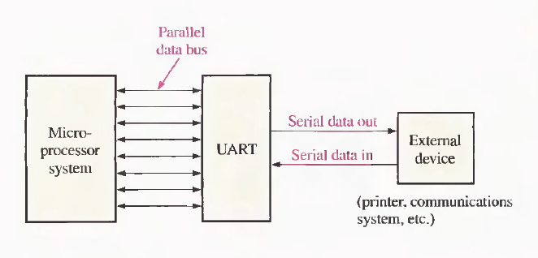
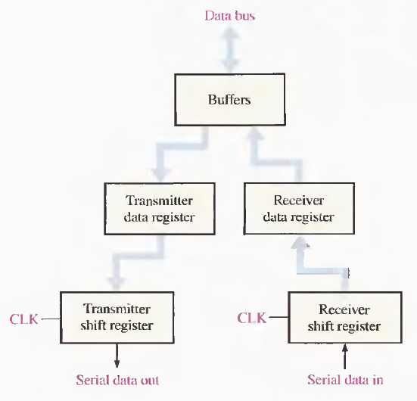
Universal Asynchronous Receiver Transmitter (UART)

Slide 31
Summary
The concept of shift register
Some kinds of shift register
  Serial In/Serial Out
  Serial In/parallel Out
  Parallel In/Serial Out
  Parallel In/Parallel Out
  Bidirectional Shift
Shift register counters
Applications

Slide 32
Assignments
Edition 10
  Page 397~398
    21
    25

